Slide 1
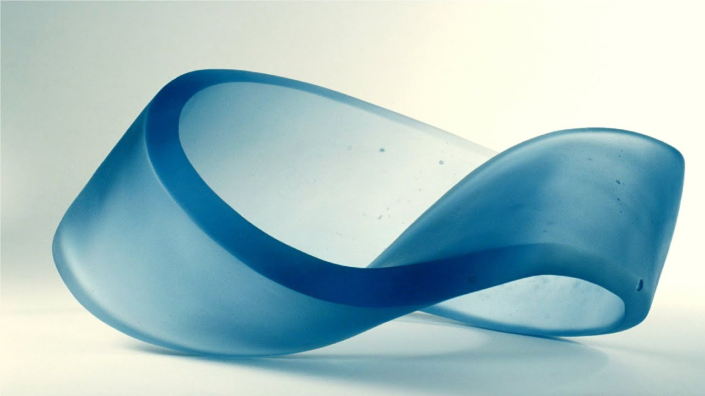
Logical paradoxes, thought experiments, antinomies and their impact on theoretical knowledge.
Created by:
Iryna Sadovska,
DA-92 Group

Slide 2
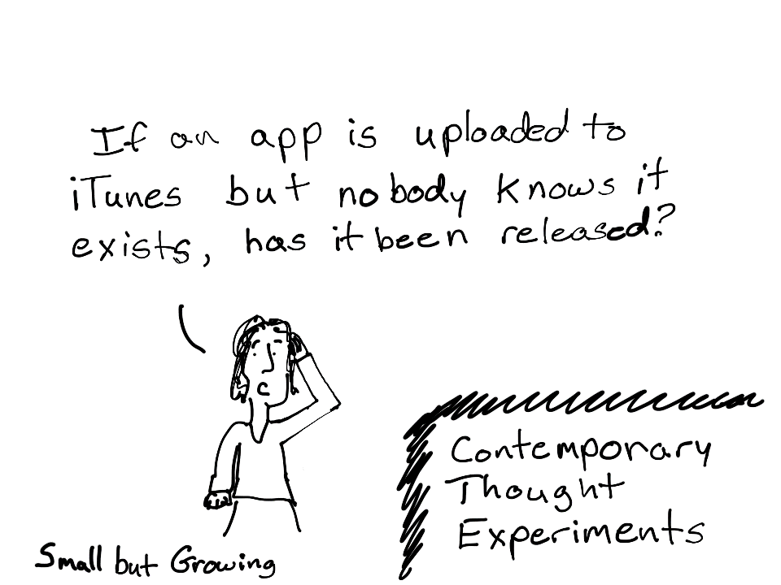
Thought experiment
In philosophy, thought experiments have been used since its inception, being closely intertwined with forecasting. Socrates used thought experiments, for example, in the well-known dilemma about death in the Apology of Socrates (let's imagine that death is eternal rest, but then it is not evil; let's imagine that death is going where all people go, this means that there you can meet many famous people with whom it would be extremely interesting to communicate, but then she is not evil, therefore, death should not be feared) or in discussions about the idea of ​​beauty in Hippia the Greater (imagine that you are one of the gods, unless for You will seem to be a more beautiful woman among people than for any person - a female monkey?).
Famous examples of thought experiments in ancient philosophy are also Zeno's Aporias, demonstrating the logical inconsistency of ideas about the continuity of space and time.

Slide 3
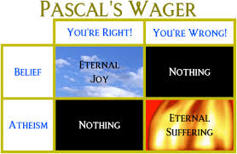
The most famous reasoning of modern times, built taking into account thought experiments, is Pascal's bet:
“What should I stake my life on - on religion or on atheism?” To find the answer, Pascal suggested that the chances of the existence or absence of God are approximately equal, or at least that the probability of the existence of God is greater than zero. Then two options are possible:It is extremely dangerous to live without faith, since the possible "loss" in the case of the existence of God is infinitely great - eternal torment. If God does not exist, then the price of the "win" is small - unbelief does not give us anything and does not require anything from us.Living according to the canons of faith is not dangerous, although a little more difficult because of the fasts, all sorts of restrictions, rituals and the associated costs and time. The cost of “losing” in the absence of God is small - the cost of rituals and efforts to live a righteous life. But the possible "gain" in the case of the existence of God is infinitely great - the salvation of the soul, eternal life.

Slide 4

What is a logical paradox?
A paradox in logic is a contradiction that has the status of a logically correct conclusion and, at the same time, is a reasoning that leads to mutually exclusive conclusions. The logical error of the paradox is due to the wrong choice of logical premises, for example, when it comes to objects that do not have a clear definition. Usually logical paradoxes are products of thought experiments.

Slide 5
Separation of paradoxes
Logical Paradox
Aporia
Antonimia

Slide 6
Aporia is a fictional, logically correct situation that cannot exist in reality. An aporic judgment fixes the discrepancy between an empirical fact and the theory that describes it. Aporias have been known since the time of Socrates
Antinomia is a situation in which conflicting statements about the same object have a logically equal justification and their truth or falsity cannot be justified within the framework of the accepted paradigm, that is, a contradiction between recognized equally true provisions, or, in other words, a contradiction of several laws

Slide 7
Examples of apories

Slide 8
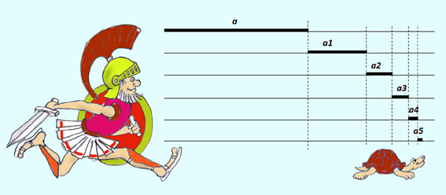
Achilles and the turtle
Achilles and the tortoise are one of the apories of the ancient Greek philosopher Zeno. This and 39 other apories contains 40 apories of Zeno. But today we Know only 9 of them.
Let's say Achilles runs ten times faster than a turtle and is a thousand steps behind it. During the time it takes Achilles to run this distance, the turtle will crawl a hundred steps in the same direction. When Achilles has run a hundred steps, the turtle will crawl ten more steps, and so on. The process will continue indefinitely, Achilles will never catch up with the turtle.

Slide 9
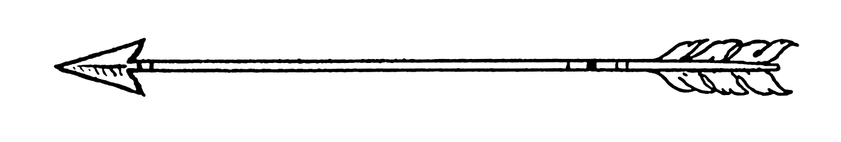
Zeno's arrow
Another one aporia from the 40 apories of Zeno. It looks by the next way:
The flying arrow is motionless, since at every moment of time it occupies an equal position to itself, that is, it is at rest; since it is at rest at every moment of time, then it is at rest at all moments of time, that is, there is no moment in time at which the arrow moves.

Slide 10
Examples of antinomies

Slide 11

Liar paradox
Liar paradox is one of the most famous logical paradoxes. There are a lot of varieties of this paradox. On of them on the image:
If this statements if false, it means that it`s true, but it false. So we see contradiction. By another way, if this statement if true, then statement if false, contradiction too.

Slide 12
Kant`s antinomies
The global system of philosophical antinomies was formulated and substantiated by I. Kant in his "Critique of Pure Reason" (1781), showing that antinomies necessarily arise in the system of judgments about being, when a person tries to comprehend it as a kind of unity of the transcendent and immanent, eternal world of "things in themselves ”And transitory empirical existence. According to Kant, such attempts to think of the world as a whole, implying the idea of ​​the unconditional or the absolute as a prerequisite, lead the mind to inevitable contradictions, since they make it possible to substantiate both the statement (thesis) and the denial (antithesis) of each of the following four "antinomies of pure reason ":The world is finite - the world is infinite.Every complex substance is made up of simple parts - nothing simple exists.There is freedom in the world - there is no freedom in the world, but only free (spontaneous) causality exists.There is an absolutely necessary root cause of the world (God) - there is no absolutely necessary essence, neither in the world, nor outside the world, as its root cause.Thus, the antinomies of reason, according to Kant, express a deeply contradictory state of the human mind ("a dispute between reason and itself"), which seeks to overcome the limitations of the rational definitions of the world.

Slide 13
Paradoxes fix the contradiction in an acute form. Numerous aphorisms expressing this very statement can serve as an example of this. For example, the following paradoxical expressions are well known: “I do not always share my views”, “Logic can frighten only logicians”, “Compared to myself, I am nothing”. They express precisely the contradiction, moreover, in a grotesque, deliberately sharpened form. The paradox does not simply state the existence of opposite approaches. He encourages the researcher to reflect on the multifaceted nature of the problem, on its constant development, on the depth of the unexplored that eternally attracts any thinking person. But, obviously, one should distinguish between the concepts of "paradox" and "logical paradox". An essential characteristic that distinguishes the first concept from the second is the formulation of logical paradoxes in logical terms, although it is natural that logical paradoxes are not rigidly separated from all other paradoxes. It is important to note that no stable classification of paradoxes has yet been proposed. Moreover, the multiplying number of paradoxes gave rise to controversies regarding the viability of logic in terms of solving emerging problems. Investigating this problem, the Russian scientist A. Ivin noted that the presence of a large number of paradoxes speaks precisely of the strength of logic, and not of its weakness. The fact is that paradoxes undermine the belief that the usual methods of theoretical thinking, by themselves and without any special control over them, provide reliable progress towards the truth. In fact, paradoxes play the role of a factor that controls and sets delimitations on the way of constructing deductive systems of logic.

Slide 14
Summary
Thought experiment is a type of cognitive activity in which a situation that is key for a particular scientific theory is played out in the imagination.
Paradox is a contradiction that has the status of a logically correct conclusion and, at the same time, is a reasoning leading to mutually exclusive conclusions. Born as a result of a thought experiments.
Paradox help to generalize, stabilize and improve theoretical knowledge and science in general.

Slide 15
Thanks for your attention

